Slide 1
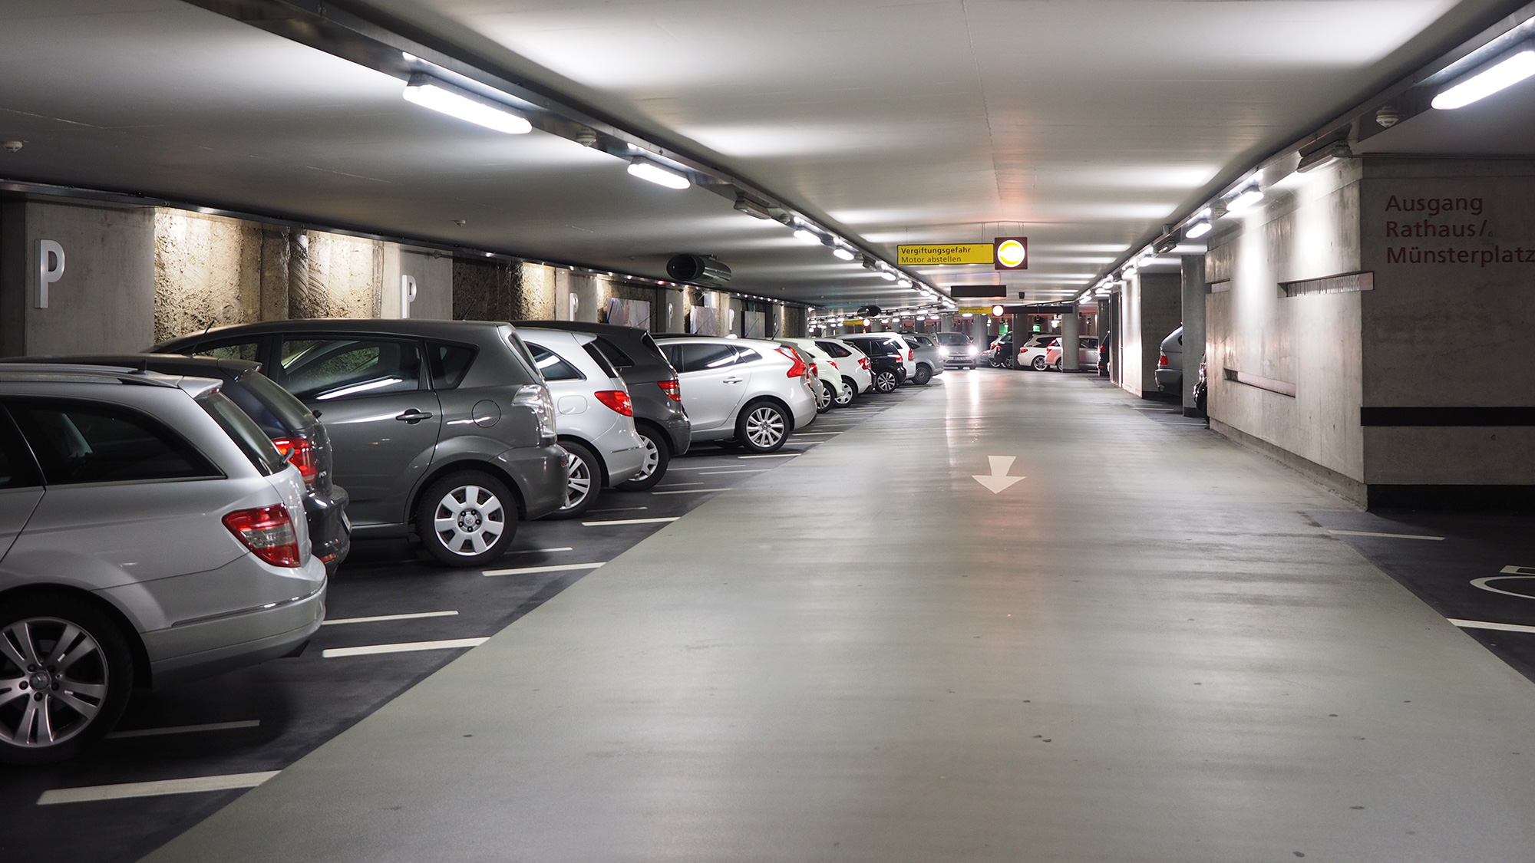
Car parking lot Management system
Presented by
Ali Raza
&
Sajal Tariq
Exploring the implementation of a car parking system using object oriented programming principle

Slide 2

Introduction
This Car Parking Management System is a C++ object-oriented program designed to simulate how vehicles are managed in a parking lot. It demonstrates key OOP concepts such as inheritance, polymorphism, encapsulation, and abstraction while providing a practical example of managing cars in a limited-capacity parking area.

Slide 3

Overview
Base class for vehicle , protected plate number attributes, pure virtual function
The Vehicle class is the main base class in the Car Parking Management System. It has a protected attribute called plateNumber which stores the vehicle’s number plate. This attribute is hidden from outside but can be used by classes that inherit from Vehicle. The class also has a pure virtual function called calculateFee(int hours). This makes Vehicle an abstract class, meaning you cannot create objects of it directly. Instead, other classes like Car must provide their own way of calculating parking fees. This design makes the system more flexible, easy to extend, and follows important object-oriented concepts like abstraction, encapsulation, and polymorphism.

Slide 4





Core Concept in Project
Abstract Class
Inheritance & Polymorphism
Encapsulation
Parking Management
User Interaction & Output

Slide 5
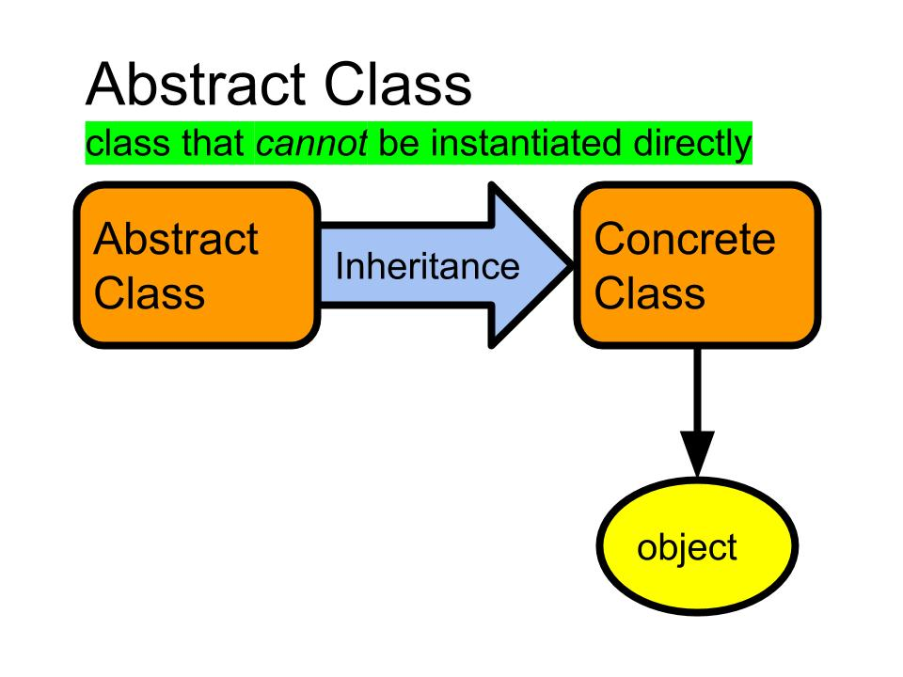
What is abstract class?
An abstract class is a class that cannot be directly used to create objects. It is meant to be inherited by other classes. It usually contains at least one pure virtual function, which means the child class must provide its own version of that function.
Example:
class Vehicle {
protected:
string plateNumber;
public:
Vehicle(string plate) : plateNumber(plate) {}
string getPlateNumber() {
return plateNumber;
}
virtual int calculateFee(int hours) = 0; // Pure virtual function
};

Slide 6
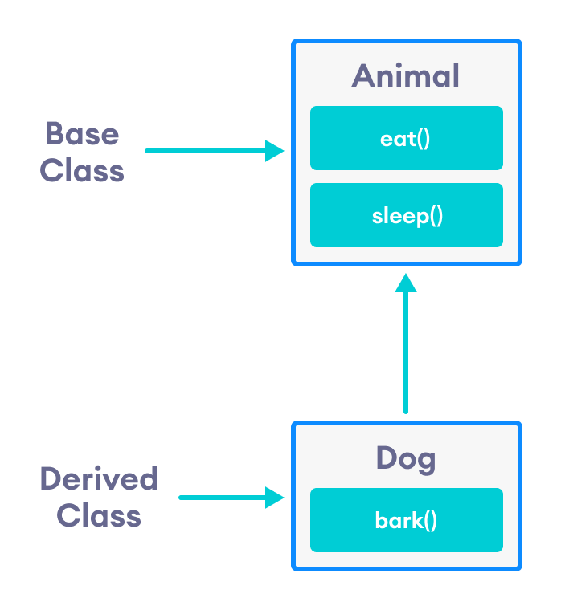
Inheritance
Inheritance means one class (child) gets properties and functions from another class (parent). It helps reuse code and build relationships between classes.
Example:
class Vehicle {
// Base class
};
class Car : public Vehicle {
// Car inherits from Vehicle
};
The Car inherits from the vehicle class.
It get access to platenumber and must implement calculateFee().

Slide 7
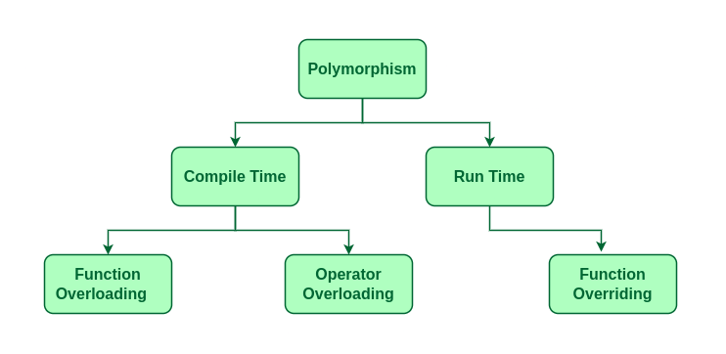
Polymorphism
Polymorphism means using a single interface to represent different types. It allows different classes to define their own behavior while being treated the same way.
Example:
Vehicle* v = new Car("ABC-123");
int fee = v->calculateFee(3);
V is a pointer of type vehicle , but it point to a car object.
When CalculateFee() is called , it run the version from the car class.
This is run time polymorphism using virtual function

Slide 8
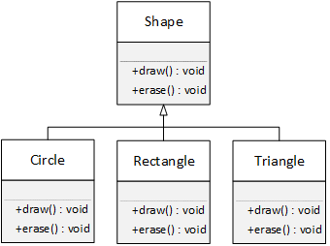
Pure Virtual Function
A pure virtual function is a function declared in a base class that has no body — it must be overridden by any derived class.
It makes the base class abstract, meaning you cannot create objects of that class directly.
Example:
class Vehicle {
public:
virtual int calculateFee(int hours) = 0; // pure virtual function
};

Slide 9
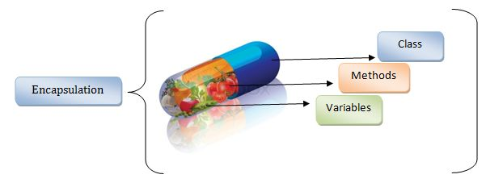
Encapsulation
Encapsulation means hiding the internal details of a class and only exposing what is necessary through public methods.
Data (attributes) are usually kept private or protected.
Access to that data is controlled using getters, setters, or functions.
This ensures security, clarity, and controlled access to the class’s data.
Example :
class ParkingLot {
private:
int capacity;
int count;
Vehicle* slots[10]; // hidden details
public:
void displayStatus() {
cout << "Capacity: " << capacity
cout << " | Occupied: " << count
cout << " | Free Slots: " << (capacity - count) << endl;
}
};

Slide 10
Special Keywords
Access specifier
Virtual
Override
new
Delete
Protected, private, Public
Used to declare function that can be overridden in derived classes
Ensure that derived class is correctly overriding a virtual function
Used to dynamically create object at runtime
Used to free memory allocated with new

Slide 11
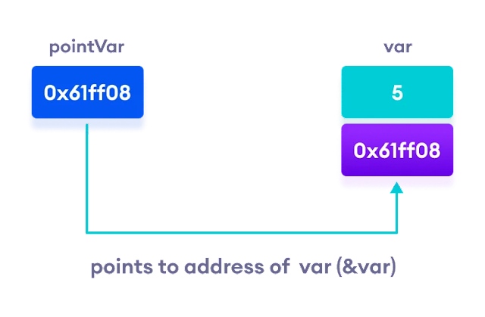
What is pointer?
A pointer in C++ is a special variable that stores the memory address of another variable or object instead of storing the actual value.
Think of it like a “reference card” that tells you where the data is stored in memory.
You use * (dereference operator) to access the value at the address, and & (address-of operator) to get the address.
Example:
Vehicle* slots[10]; // array of pointers to Vehicle objects
Vehicle* v = new Car("ABC-123");

Slide 12
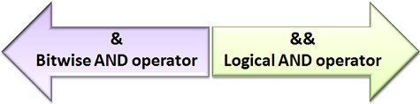
What is & in C++
The ampersand (&) has two main uses in C++:
Address of operator :
When used before a variable , it gives the memory address of that variable .
Example:
int x = 10;
cout << &x; // prints the memory address of x.
Reference in Function Parameters :
When used in a function parameter, it means the function work with the original variable , not a copy .
Example:
lot.parkVehicle(&c1);

Slide 13



Parking Lot Class Structure
Core Management Structure
Fix Size Array For storage
Capacity Tracking

Slide 14
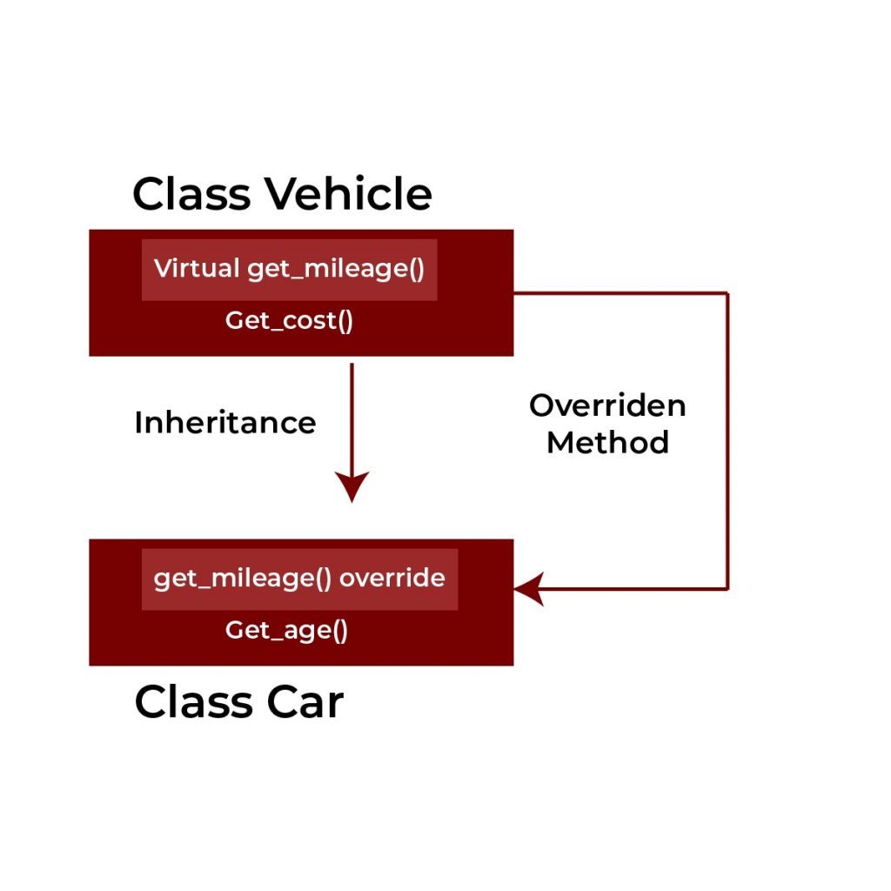
Override
Override is a special keyword in C++ used in derived classes .
It tells the compiler that a function is meant to replace (override) a virtual function from the base class.
This ensure you don’t make mistakes – if the base class doesn't have a matching virtual function, the compiler will give an error.
Example :
class Vehicle {
public:
virtual int calculateFee(int hours) = 0; // pure virtual function
};
class Car : public Vehicle {
public:
int calculateFee(int hours) override { // override keyword
return hours * 50;
}
};

Slide 15



Parking Vehicles:
Process Overview
Attempt To park vehicle
Parking Vehicle and update Occupancy
Check for Available Slots
Initiate the parking process by selecting a vehicle to park
If space is available, park the vehicle and increment the count of occupied slots
Evaluate the current Occupancy against the parking lot’s capacity

Slide 16
Method in Parking lot Class
Park Vehicles method Implementation
Remove Vehicle method details
Display Status method Function
This method show the current condition of the parking lot– how many slots are full , how many are free, and which vehicles are parked
This method finds the vehicles using its plate number, remove it from the slot , and calculate the parking fee based on how many hours it was parked
This method check if there’s space in the parking lot. If yes ,it adds the vehicles to the next empty slot

Slide 17
Removing Vehicles:
Process Overview
Attempt to Remove vehicles
Initiate the process by searching for the vehicle using its plate number
Determine the total fee based on the time the vehicle was parked
Calculate Parking fee
Shift the Remaining vehicles to fill the empty slot and adjust the current occupancy count
Update vehicle Slots

Slide 18
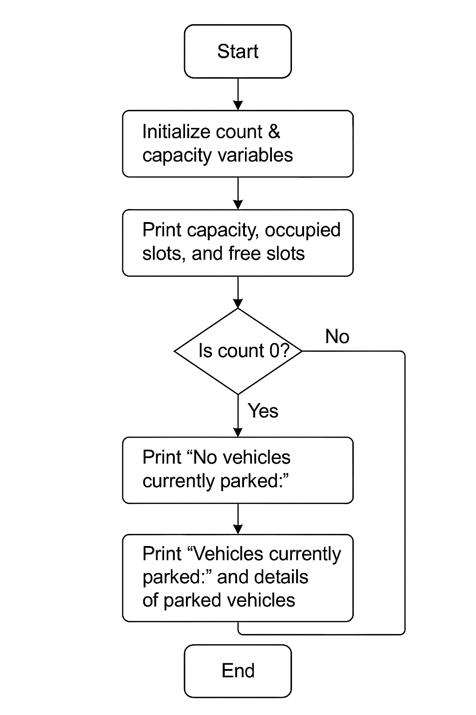
Displaying Parking Lot status
The displayStatus() function is used to show the current condition of the parking lot in a clear way. It prints the total capacity, how many slots are filled, and how many are still free. If no vehicles are parked, it shows a message saying the lot is empty. If there are vehicles inside, it lists each one along with its slot number and plate number. This makes it easy for users to quickly see which cars are parked and whether space is available.
Example:
lot.displayStatus();
========== Parking Lot Status ==========
Capacity: 3 | Occupied: 3 | Free Slots: 0
Vehicles currently parked:
- Slot 1: BMW M5 F90-360
- Slot 2: Corvette C8-45
- Slot 3: AUDI RS6-320
========================================

Slide 19
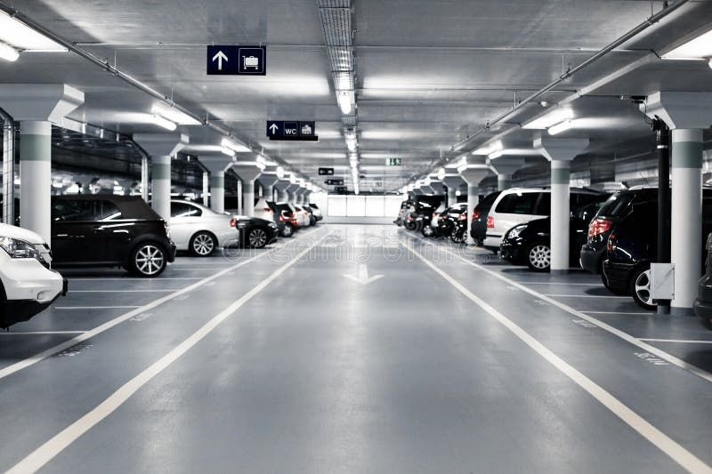
Program
#include <iostream>
#include <string>
using namespace std;
// Base class Vehicle
class Vehicle {
protected:
string plateNumber;
public:
Vehicle(string plate) {
plateNumber = plate;
}
string getPlateNumber() {
return plateNumber;
}

Slide 20
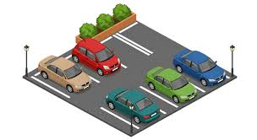
virtual int calculateFee(int hours) = 0; // pure virtual function
};
// Derived class Car
class Car : public Vehicle {
public:
Car(string plate) : Vehicle(plate) {}
int calculateFee(int hours) override {
return hours * 50; // Rs.50 per hour
}
};
// ParkingLot class
class ParkingLot {
private:
int capacity;
int count;
Vehicle* slots[10]; // fixed size array

Slide 21
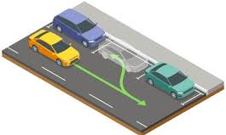
public:
ParkingLot(int cap) {
capacity = cap;
count = 0;
}
void parkVehicle(Vehicle* v) {
cout << "\n----------------------------------\n";
cout << "🚗 Attempting to park vehicle...\n";
if (count < capacity) {
slots[count] = v;
cout << "✅ Vehicle [" << v->getPlateNumber() << "] parked successfully.\n";
cout << "Current Occupancy: " << count+1 << "/" << capacity << endl;
count++;
} else {
cout << "❌ Parking lot is FULL! Cannot park vehicle [" << v->getPlateNumber() << "].\n";
}
cout << "----------------------------------\n";

Slide 22
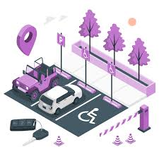
void removeVehicle(string plate, int hours) {
cout << "\n----------------------------------\n";
cout << "🚗 Attempting to remove vehicle...\n";
for (int i = 0; i < count; i++) {
if (slots[i]->getPlateNumber() == plate) {
int fee = slots[i]->calculateFee(hours);
cout << "✅ Vehicle [" << plate << "] removed successfully.\n";
cout << "Parking Duration: " << hours << " hour(s)\n";
cout << "Total Fee: Rs." << fee << endl;
// shift remaining vehicles forward
for (int j = i; j < count - 1; j++) {
slots[j] = slots[j + 1];
}

Slide 23
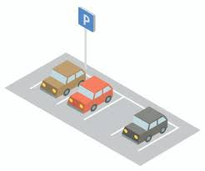
count--;
cout << "Current Occupancy: " << count << "/" << capacity << endl;
cout << "----------------------------------\n";
return;
}
}
cout << "❌ Vehicle [" << plate << "] not found in parking lot.\n";
cout << "----------------------------------\n";
}
void displayStatus() {
cout << "\n========== Parking Lot Status ==========\n";
cout << "Capacity: " << capacity << " | Occupied: " << count << " | Free Slots: " << capacity - count << endl;
if (count == 0) {
cout << "No vehicles currently parked.\n";

Slide 24
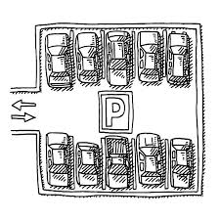
for (int i = 0; i < count; i++) {
cout << " - Slot " << i+1 << ": " << slots[i]->getPlateNumber() << endl;
}
}
cout << "========================================\n";
}
};
// Main function
int main() {
cout << "========================================\n";
cout << "🚘 Welcome to Car Parking Lot System 🚘\n";
cout << "========================================\n";

Slide 25
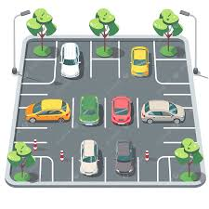
Car c1("BMW M5 F90-360");
Car c2("Corvette C8-45");
Car c3("AUDI RS6-320");
lot.parkVehicle(&c1);
lot.parkVehicle(&c2);
lot.parkVehicle(&c3);
lot.displayStatus();
cout << "\n>>> Removing vehicle AUDI RS6 after 2 hours...\n";
lot.removeVehicle("AUDI RS6-320", 2);

Slide 26
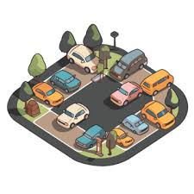
lot.displayStatus();
cout << "\n✅ Program finished successfully.\n";
cout << "========================================\n";
return 0;
}

Slide 27

Conclusion and Future Enhancement
The future of parking management lies in automation and smart technology.
Potential enhancements include mobile app integration, real-time availability updates, and advanced fee calculation systems to improve user experience and operational efficiency.

Slide 28
Thank You

